Slide 1

Leveraging Technology to Improve Your Risk Management Practices
Steve NyBlom, County of Los Angeles
Tim Karcz, California JPIA

Slide 2


Introductions
Tim Karcz, CSP, ARM-P
Senior Risk Manager
California JPIA
Steve NyBlom
Manager, Risk Management
County of Los Angeles
Notes:
Introductions - Steve and I both work with public agencies; however, our agencies have stark differences.
Steve is from one of the largest in the country, LA County. I work with a number of smaller cities and special districts within California. Different budgets, different priorities, somewhat similar exposures.

Slide 3
Leveraging Technology
Organizations large and small must determine how to leverage technology and other resources to maximize the effectiveness and efficiency of their safety and risk management programs.
Notes:
This statement is straight from our session description.
This session will fall short of campaigning for new technology. We all want to do this. What we are going to focus on today is leveraging technology to improve safety and risk management. Key aspects of what systems will do for you that make it necessary to strive towards better budgets for technology.

Slide 4
What We Want to Talk About Today
Technology
  benefits for safety and risk management
Challenges
Point to Common Resources
County of Los Angeles Case Study
Notes:
Discuss what we are hoping to accomplish today in this session

Slide 5


Historical Perspective
Notes:
The simple ability for a system to complete a task doesn’t mean it’s anything and everything you need. We all want upgrades, but the resistance to change can be strong, especially from those managing the budgets. Planning is vital for any move forward. But that doesn’t mean you have to jump from this, to this…..(schematic slide)

Slide 6
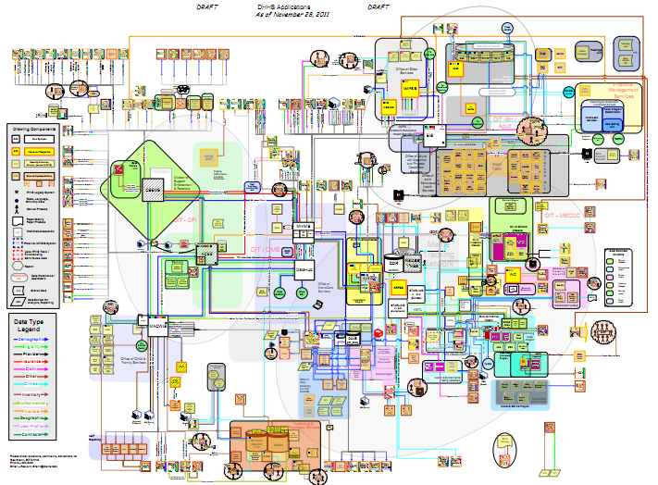
Notes:
This is what technology looks like to a lot of people. You need to strive to be more independently thinking per your organization’s specific needs. Homing in on costs drivers is key, but just as important is identifying where the inefficient/redundant/bottleneck areas area.

Slide 7
The Need for Technology
Starts with a needs assessment
Example: Long term cost savings and increased efficiency
Purpose
Goals
Actions
Notes:
Discussion on the need for technology, being proactive, and the power of investing.
Assessing what you need is a critical step. Start with identifying a purpose, establishing goals to drive towards that purpose, and creating specific actions to meet the goals.
Discuss up front challenges
Money
Management Buy-In

Slide 8

Some Systems Are Simple
Like a Rolodex
Notes:
Some systems are simple, like a rolodex. Evaluating systems for technological needs starts with a needs assessment.

Slide 9
The Need for Technology
Addressing cost drivers is important, but when considering how technology can help you must also identify inefficient, redundant, and bottlenecking activities.
Notes:
Establishing a need for technology shouldn’t just be to spruce up a current process, or to make it prettier. It should include solutions to fix real issues, like inefficient activities, redundant processes, or bottlenecks. The system should produce actionable changes.

Slide 10
Benefits of using online and virtual tools
Being Proactive Rather than Reactive
Can be rolled out to multiple sites
Single location to review data
User friendly
Self learning, self adjustment
Identify high risk
Data for leadership
Notes:
Technology can help with your approach to managing risk. Here are a few examples.

Slide 11
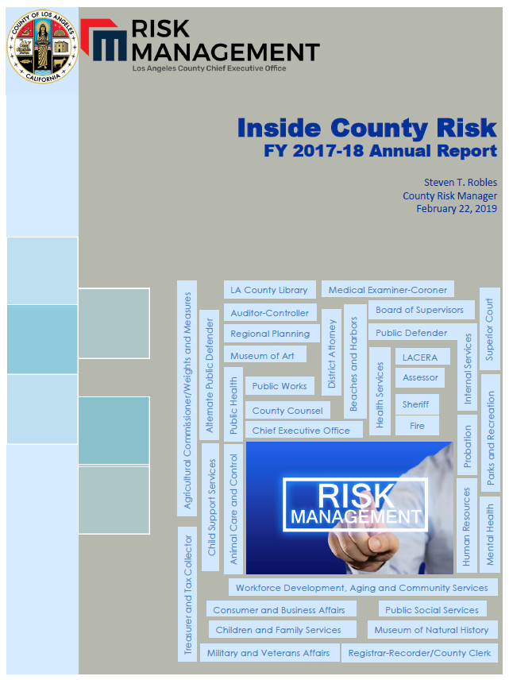
Approach to Risk Management
Identify trends and patterns relating to safety and risk management
  Study and analyze all liability and work comp data (weekly)
Educate stakeholders about trends and solutions
  Annual report
  Risk Management Plans
  Easy-to-view dashboards
Provide tools to improve conditions or minimize risk
  Educational material & training sessions
Monitor results on a continual basis
Notes:
Technology can help with your approach to managing risk. Here are a few examples.
Using dashboards to present information
Educate

Slide 12
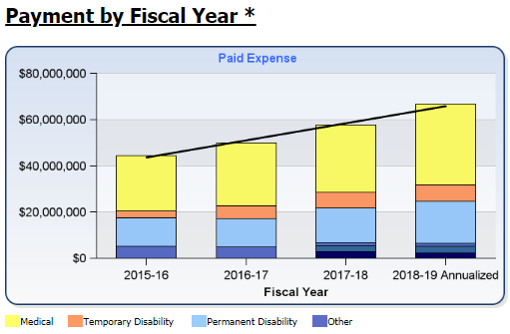
Accomplishing Results by Embracing Technology
Enterprise Risk Information Center dashboard
  Workers’ compensation data
  Liability data by different exposures (general liability, employment, law enforcement liability, vehicle, medical malpractice)
  Trend graphs and charts
  Drill-down detail reports
Obtain data and use predictive analytics
  IBM SPSS Modeler Gold
Notes:
Technology presents information in the way you tell it to. A dashboard enables you to visualize things in a way that creates action. This chart shows a very poor trend line for a given department. This gives you the opportunity to focus on this particular department. The tech should enable you to drill down on this even further.

Slide 13
Accomplishing Results by Embracing Technology
  Media 2 – Dashboards on Claims Cause and Frequency
Notes:
Technology can help with your approach to managing risk. Here are a few examples.

Slide 14
Accomplishing Results by Embracing Technology
Make everything digital
  Web-based training
  Resource and model documents
  App development
  Specific issue tech tools (ergonomic self-assessment program; vehicle telematics; driver pre- and post-crash video camera)
Notes:
Technology can help with your approach to managing risk. Here are a few examples.

Slide 15
Accomplishing Results by Embracing Technology
  Media 1 – Incident Reporting App
Notes:
Technology can help with your approach to managing risk. Here are a few examples.

Slide 16
Up-Front Challenges
These need to be met head on……
Money
Management Buy-In
  Identifying and Presenting the Return on Investment
  Valuing and Displaying Risk
  Using Predictive Analytics
Notes:
Research and display some challenges to getting technology in place……look for data in Pro-Safety. Return on Investment is an important piece of this discussion. Introduce it here and then get into it further on the next slide.

Slide 17
Using Return on Investment
Common metric used for evaluating, approving and measuring the success of any significant investment, including software purchases.
  O’Neill, P. (2015). Measuring the Return on Investment in a Risk Management Information System
Notes:
Return on investment is one of the critical elements to this discussion. The common definition as defined by O’Neil. Discuss ROI resources, including various articles available on ASSP Professional Safety and other sessions at the PDC.

Slide 18
Using Return on Investment
ROI =
Gain from investment over some period of time
–
Cost of investment over the same period of time
/
Cost of investment over the same period of time
Notes:
O’Neil also provides a basic formula for considering this.
The second variable, while not apparent now, will eventually become apparent when considering actual systems. The first variable, however, is what this presentation focuses on. Understanding the gain in value with technology.

Slide 19
ROI – Gains From Investment
Risk Management/Administrative Costs
  Process improvement to increased productivity
Risk Transfer Costs
  Improved quality of information – better information leads to better decisions, including at the underwriting level
Retained Risk Costs
  Better information leads to better decisions about risk tolerance
Notes:
Identifying the gains from investment can be tricky, and somewhat subjective. Here are three themes to help you home in on where improvements can be measured.

Slide 20
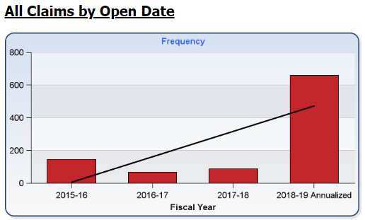
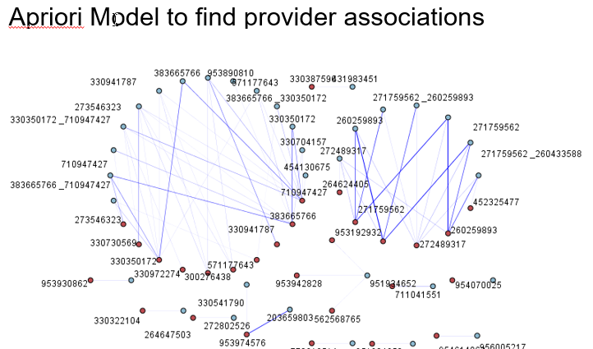
Valuing and Displaying Risk
Using Dashboards:
Instant insights can be
key to success
Two Examples:
Loss Trends and Cost Drivers
  Using Leading Indicators
Fraud Detection
  Using predictive analytics to let
  the system show you a potential
  problem exists
Notes:
Another method for showing how technology can improve your world is information available at your fingertips. Dashboards can provide instant insight and can lead to great decision making with reduced time and effort. Two areas this can be super helpful is reviewing loss information and fraud detection.
Defer to Steve to discuss what the charts are showing us.

Slide 21

Using the Information
Notes:
Set up correctly, the context is in front of you. Using the information given to you is not necessarily the purpose of the presentation, but it’s important to utilize professional knowledge.

Slide 22
Claims Metrics
Financial Metrics
Insight
Context
What Data to Focus On
Where To Look
What To Do With It
Notes:
With this in mind, our goal today is to lead a conversation that targets approaches and methodologies to building key metrics in claims and finances in our world of pool management and pool participation. The primary reason is this [switch to next slide].

Slide 23
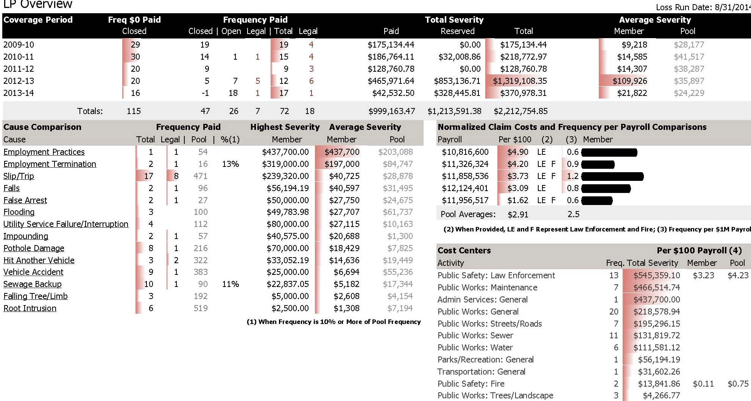
Valuing and Displaying Risk
Notes:
An example of a basic dashboard for liability claims over the last 5 years. Simple predictive analytics can point to you the most relevant information. He we see the dashboard telling us when a specific claim, or set of claims, averages over 10% of the total claims. We also see a color coded display designed to draw our attention to increasing costs.

Slide 24
Valuing and Displaying Risk
  Creating Actionable Information is Critical
  Does the system provide you with:
  Cost drivers by department
  Business partner cost drivers
  Job tasks, root cause, etc.

Slide 25
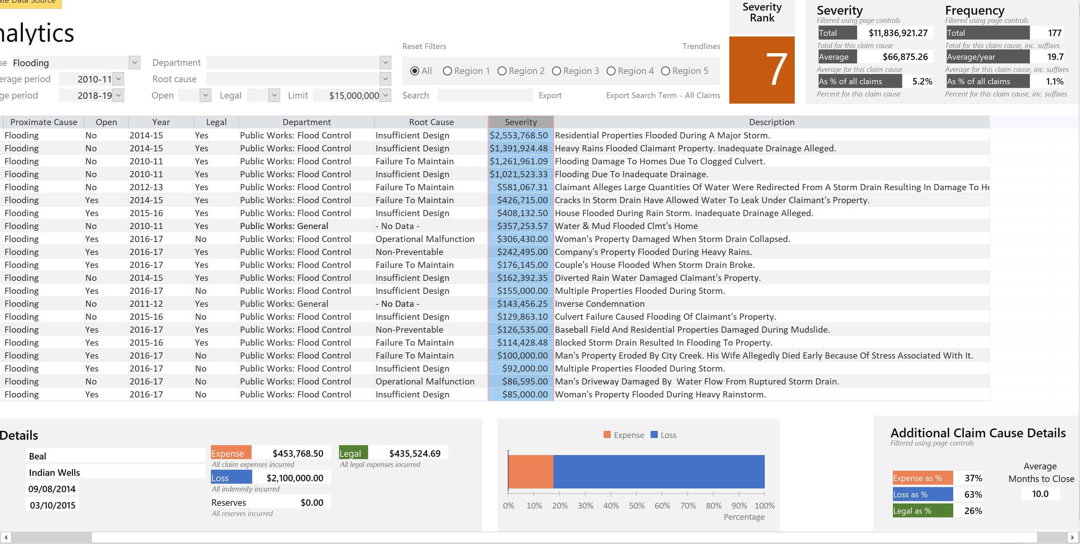

Slide 26
Using Predictive Analytics to Identify Fraud
Without Predictive Analytics:
  Fraud detection is likely Reactionary in nature – likely relying on a referral-based approach (whistle blowing or discovered by accident)
With Predictive Analytics:
  Adopt a Proactive approach in fraud detection.
  Models are developed and scored to uncover anomalies and suspicious behavior/patterns. Business team then takes the model results as potential “red flags” for further investigation.

Slide 27
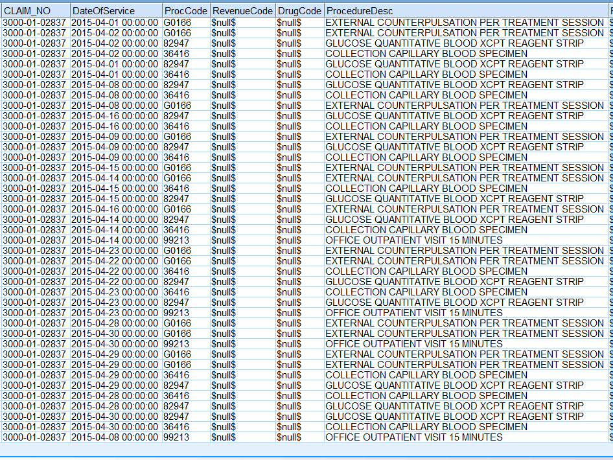
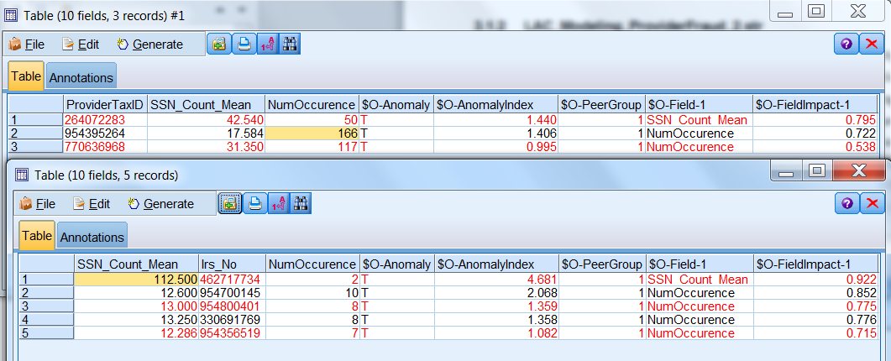
Example of Predictive Analytics
Excessive Monthly Billing per Patient/Claimant
On average, providers bill the County 2 times per month
710919710: WEAVER MD, RONALD
Billed 28 times for a single patient
during April 2015
Notes:
The model produced data showing us excessive or strange monthly billing practices.

Slide 28
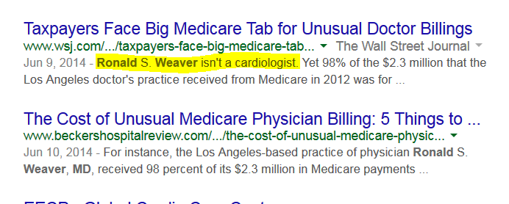
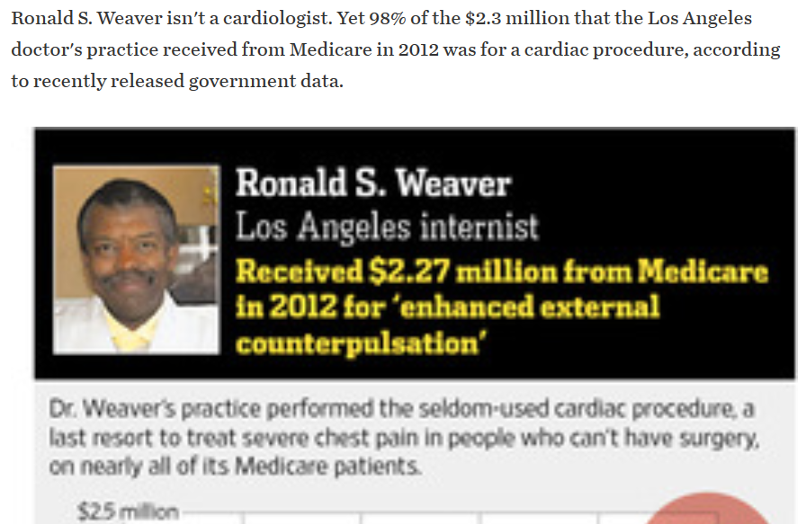
Example of Predictive Analytics
Notes:
This is what we found when we googled this doctor.

Slide 29
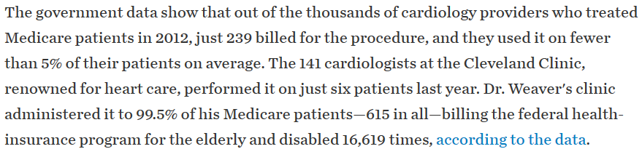
Example of Predictive Analytics
Excessive Monthly Billing per Patient/Claimant

Slide 30
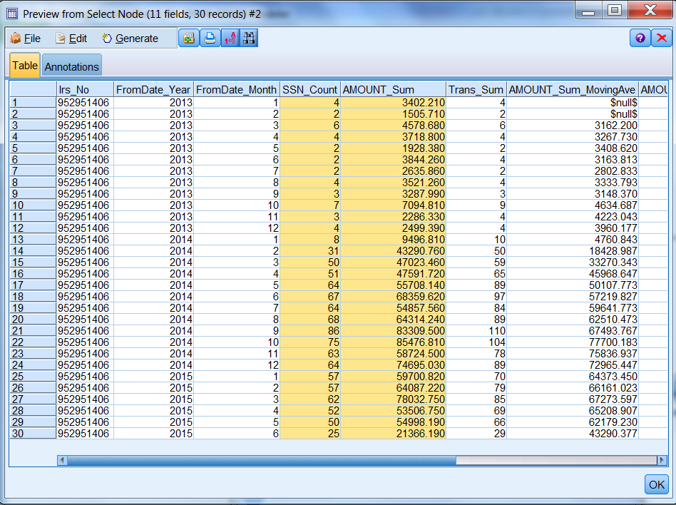
Other Examples
Acceleration of monthly billing levels
Notes:
What happens when you have a provider billing you a small amount of times, but then it really jumps. What is the reason for this? How did they go from a lower level of service to a higher level of service. Is it real or fraudulent?
Part the predictive analytics model is that it points data in the direction of a human to look at it. This may be perfectly legitimate, but regardless this is data that needs to be reviewed by a human.

Slide 31
Partner Resources
Consider the resources available from your business partners
What do they do today that they did not do 15 years ago?
Examples:
Underwriting processes that produce other services that you can use – building valuations, exposures disclosed on U.R.
Current RMIS systems that you can have access to

Slide 32
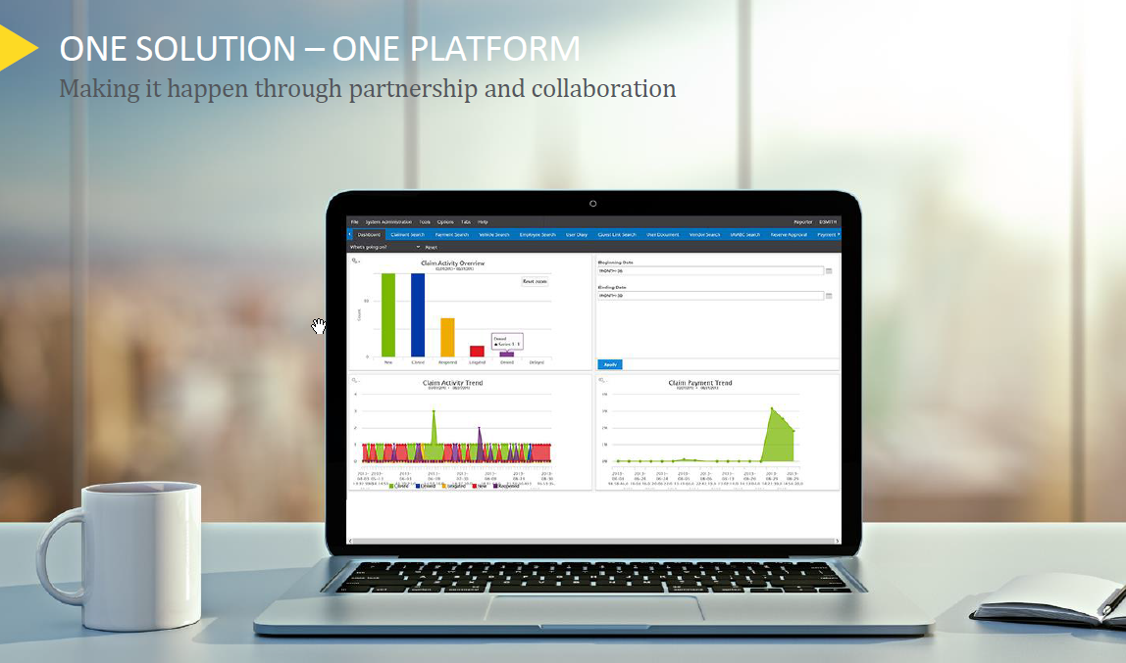
Other Technologies Available
Cognos
Power BI
Watson Analytics

Slide 33


Case Study
County of Los Angeles
https://riskmanagement.lacounty.gov/

Slide 34
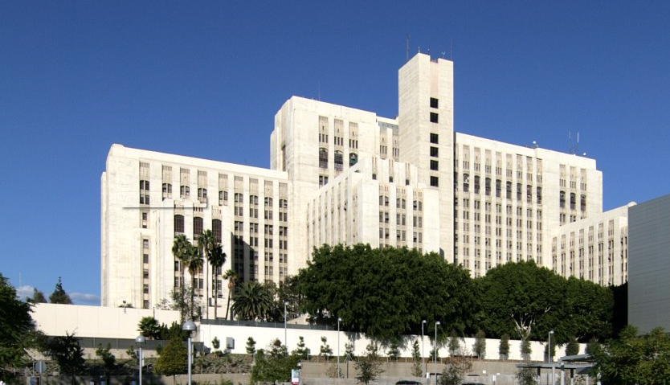

County of Los Angeles Overview
Over 100,000 employees
  This is 1% of the population of the County
  More residents than in 42 states
Over 4,700 square miles of area
  70 miles of coastal land
  Mountains, valleys, forests, lakes, rivers, deserts
Budget exceeding $30 billion
  Law enforcement, healthcare, fire protection, social services
Cost of risk approaching $650 million
  25% liability related; 75% workers’ compensation/salary continuation

Slide 35


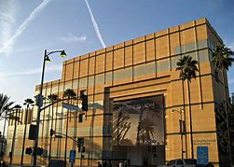
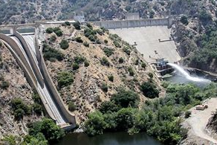
Risk Management Concerns
Public Safety
  Patrol, jails, probation, district attorney
Healthcare
  Hospitals and clinics, public health, mental health
Maintaining roads and infrastructure
  Roads, storm channels, dams
Providing recreational services
  Beaches, parks, pools, libraries, museums, theaters
Social Services
  Children and family, public social services

Slide 36
Risk Management Concerns
Centralized and decentralized functions
  Policy making departments
  Department-level implementation
Ensuring consistency of approach
  Distributed staff
  Varying levels of risk management expertise
Obtaining buy-in at all levels
  Board of Supervisors
  Department Executives
  Line staff

Slide 37
Challenge
Multiple
Systems
Same data, manual input, multiple errors
Limited security for Name, DOB, SSN, Pay, Etc.
Workflows
Lacking any technological flexibility
Static Analytics
Aged Systems
Divided authority between CEO, Department of Human Resources, Auditor-Controller, County Counsel and Departments
Limited Department access = limited data = higher claim costs
Accomplished by programming
No cross platform searching for root causes
Requiring programming for simple tasks (i.e., reports)

Slide 38



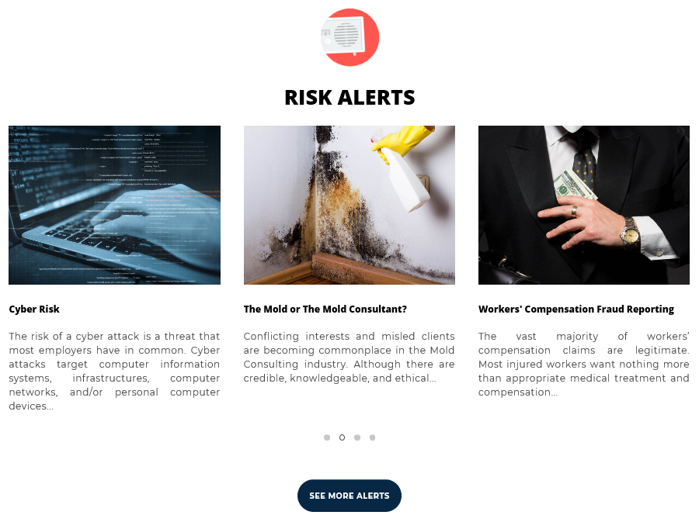
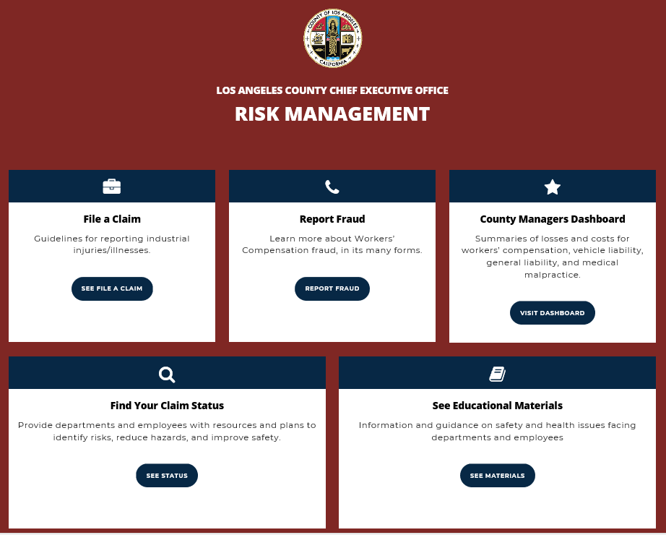
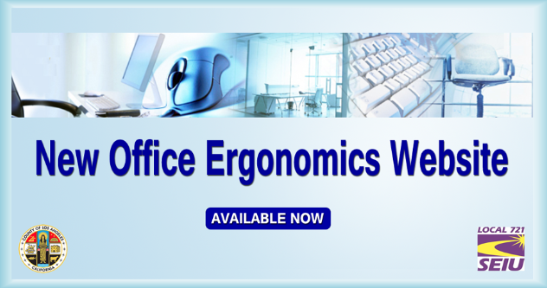
County of Los Angeles – Getting Started
Notes:
These resources did not exist 5 or 6 years ago. At some point, you have to get started with the development of this.

Slide 39
EHR
Med Mgmt
INCIDENTS
AC
State DIR
INVOLVED PARTIES
DISABILITY MGMT
WC TPAs (3)
WC CLAIMS
CLAIMVISION
OSHA
Current State - Disconnected
County Counsel
RMB
Matter Mgmt
Medicare
RCMS
Gen Legal
A-C
RMIS
County Depts
RMIG
Sheriff Expedited
COGNOS
E-DATA PAPER FILES
Liability TPAs (2)
Small Claims
LOSS CONTROL

Slide 40
Next Step: PROJECT SCOPE
Four Modules – Four Stages – Four Live Dates
  Module 1 - Claims Management System, Corrective Action Plans, and Matter Management System
  Module 2 – Workers’ Compensation System
  Module 3 - Disability / Absence Management System
  Module 4 - Loss Control & Prevention System
Notes:
Four (4) work streams defined as trials
1. Claims Management – General Claims; 2. Workers Compensation; 3. Disability Management; and 4. Loss Control & Prevention
Focus Areas:
Project Plans and Timelines
Scope Verification and Control
Product Development Activities
Interface Set-up
Data Conversion
Quality Control and Traceability
Change Management & Cost Control
Performance Reporting
Risk & Deficiency Management

Slide 41

Future State - Connected
Probation
Children & Family Services
Incident Reporting
Litigation Mgmt
Public Works
Loss Control
Fire
Disability Mgmt
New RMIS
Data Analytics
Corrective Action Plans
Health Services
Finance / Insurance
A - C
Sheriff
Risk Mgmt Claims
Park & Recreation
Other Departments

Slide 42


Integrated Systems (Desired State)
Claims Admin.
Corrective Action
Plan System
Insurance
Policy Mgmt
Disability Mgmt
System
Loss Control
Safety System
Incident Reporting

Slide 43
Vision
Integrated system
Collaborative design
(CEO, County Counsel, CIO, A-C, Human Resources)
2-click data analysis
Digital claims & litigation mgmt.
Department input of risk data
Notes:
This slide builds on obtaining management buy-in for upping your department’s technology. Return on investment is one of the critical elements to this discussion.

Slide 44
YOUR FEEDBACK IS IMPORTANT
Session Evaluations can be completed:
On the Safety 2019 App
Using the link in the email reminder you will receive at the end of each day

