Slide 1
COVID-19 and PPE: An Evolving Process Rajkiran Kullar, MPH, CIC William Brown, BSN, RN Anjali Bisht, MPH, CIC Infection Preventionists at UCLA Health 11/18/2020
Slide content also provided by Sarah Sweeney, Director of UCLA Health EID program

Slide 2
Background of UCLA Health

Slide 3
EID Preparedness Program at UCLA Health
Background
Ronald Reagan UCLA Medical Center became an Ebola Treatment center in Winter 2014.
EID Preparedness Program began in Spring 2015 to maintain and expand preparedness efforts
Program Overview
Develop and maintain comprehensive response program to equip UCLA Health staff with the necessary tools, resources, and training to safely identify, isolate, and care for any EID patient.
Collaborative and multidisciplinary approach

Slide 4
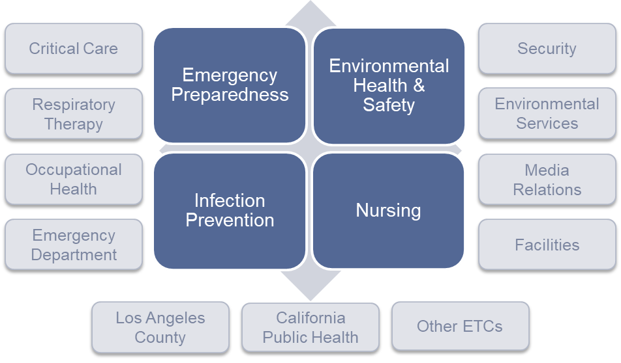
EID Response: Collaborative and Multidisciplinary Approach

Slide 5
Evolution and Expansion of EID Program
Ebola 2014-2015
MERS 2015-2020
Ebola 2018-2020
COVID-19 2020-?
Disease X

Slide 6
COVID-19 Response Thus Far at UCLA Health
January 17-March 12
9 EID Response Activations (ED walk-ins, LAX patient transports, direct admit)
Utilized MERS response protocols
Foreign travel screening dictated response
SOP development and training
March 12 - present
Support response – PPE & safety guidance, trainings, etc.
SOP development
Just-In-Time Training

Slide 7
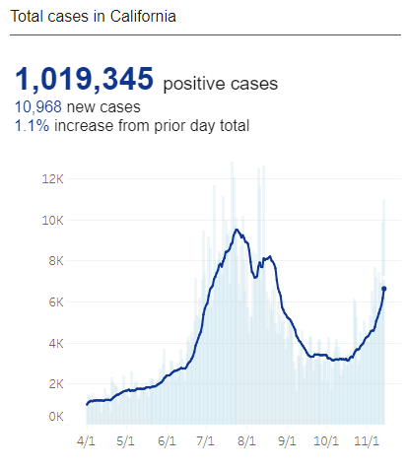
COVID-19 in California
Last updated 11/14/2020
Attitudes of PPE use
Shock and overuse of PPE
Mistrust in guidelines
PPE Fatigue
Cutting corners with PPE use
How can each impact healthcare systems?
Source: https://covid19.ca.gov/state-dashboard/

Slide 8
Timeline of PPE Modifications at UCLA Health
 | Jan – April | April – Oct | Oct - Present
Gown | disposable OR gown | single use reusable isolation gown | single use reusable isolation gown
Respiratory Protection | PAPR | If Aerosol Generating Procedure (AGP): PAPR or N95 If non-AGP: Surgical Mask | PAPR or N95 for all suspected or confirmed cases
Eye Protection | (with PAPR) | If AGP: Face Shield or Goggles If non-AGP: above or safety glasses | If suspected or confirmed: Face Shield or Goggles If low suspicion: above or safety glasses
Gloves | Double Gloving | Single Gloves | Single Gloves
Booties | N/A | N/A | N/A
Hair Bonnets | N/A | N/A | N/A
Notes:
Important to note that ALL changes were based off of guidance that was known at the time which evolved as new guidance was published

Slide 9
Rationale of the Updates
Cal/OSHA updated their guidance to use respiratory protection for suspect/confirmed COVID-19 patients, based on the current stability of the respiratory protection supply chain
These PPE changes are also possible due to a reduction in COVID-19 cases
There is no new evidence suggesting that COVID-19 is an airborne disease like measles or TB, but there are instances where SARS-CoV-2 may become aerosolized (e.g. during aerosol-generating procedures).

Slide 10
Summary of PPE Guidance Updates
Personal Protective Equipment
Level 2 PPE will be used for care of suspected/confirmed COVID-19 patients.
Level 1 PPE will be used for patients that are low suspicion for COVID-19.
Refer to updated COVID-19 PPE guidance for detailed information on PPE for patient care, room cleaning and patient transport in various settings (inpatient, emergency department, ambulatory)
COVID-19 case definitions have been added:
Suspected COVID-19 patient
Low suspicion for COVID-19: patients being screened for COVID-19 that do not meet the suspected case definition (i.e. pre-admission and pre-procedure testing)

Slide 11
COVID-19 Clinical Case Definitions
Confirmed COVID-19 case: any patient, symptomatic or asymptomatic, who has received a positive COVID-19 test result and is still on enhanced droplet & contact isolation based on symptoms & timing.
Suspected COVID-19 case:
Inpatient areas: a patient categorized as high clinical suspicion for COVID-19 – the patient requires inpatient hospitalization and shows signs of influenza-like illness (ILI) (i.e. fever, cough, lymphopenia or increased oxygen requirement)
Emergency department: any symptomatic patient (influenza-like illness (ILI) symptoms) clinically suspected for COVID-19
Ambulatory clinics: any symptomatic patient (influenza-like illness (ILI) symptoms) clinically suspected for COVID-19
Low Suspicion for COVID-19:
Patient presents with a disease, injury, or disorder requiring inpatient hospitalization but shows NO signs of ILI

Slide 12
Ambulatory Clinics
Suspected COVID-19 case
Signs of influenza-like illness (ILI) (i.e. fever and cough, shortness of breath, sore throat, or nasal congestion)
Confirmed COVID-19 case
Received positive COVID-19 test result
Symptomatic or asymptomatic
Less than 14 days from symptom onset AND at least 72 hours without fever off antipyretic drugs AND resolution of symptoms
COVID-19 Pre-Procedural Screening
Shows no signs of influenza-like illness (ILI) (i.e. fever and cough, shortness of breath, sore throat, or nasal congestion)
Needs COVID-19 test for procedure only
Not being tested for COVID-19
Any asymptomatic patient or symptomatic patient not clinically suspected for COVID-19
Patient recovered from COVID-19
COVID-19 Test Results Received
COVID-19 Test Results Pending
Negative
Positive
Follow standard & transmission-based precautions based on symptoms
Enhanced droplet & contact precautions
PPE for Patient Care – Level 1 PPE
Surgical mask and eye protection (UCLA Health-approved face shield or safety glasses)
Gown
Gloves
PPE for Patient Care
Universal Masking & Eye Protection
Follow standard & transmission-based precautions based on symptoms
PPE for Patient Care – Level 2 PPE
N95 respirator and eye protection (UCLA Health-approved face shield or safety goggles) or PAPR
Gown
Gloves
PPE for Room Cleaning
Surgical mask, eye protection, and gloves (gown not required)
If aerosol-generating procedure performed, wait one hour prior to entering for cleaning

Slide 13
Challenges to Ambulatory PPE workflows
Education-due to staff being rotated monthly, education was constantly needed
PPE distribution consistency
Workflow consistency-resolved quickly

Slide 14
Emergency Department
Suspected COVID-19 case
Signs of influenza-like illness (ILI) (i.e. fever, and cough, shortness of breath, sore throat, or nasal congestion)
Confirmed COVID-19 case
Received positive COVID-19 test result
Symptomatic or asymptomatic
*on enhanced droplet & contact isolation based on symptoms & timing
COVID-19 Screening
Pre-admission COVID-19 testing
Shows no signs of influenza-like illness (ILI) – patient presents with disease, injury or disorder requiring inpatient hospitalization
Categorized as low clinical suspicion for COVID-19
COVID-19 Test Results Received
COVID-19 Test Results Pending
Negative
Positive
COVID-19 Test Results Pending
COVID-19 Test Results Received
Follow standard & transmission-based precautions based on symptoms
Negative
Positive
Enhanced droplet & contact precautions
PPE for Patient Care – Level 2 PPE
N95 respirator and eye protection (UCLA Health-approved face shield or safety goggles) or PAPR
Gown
Gloves
PPE for Patient Care – Level 1 PPE
Surgical mask and eye protection (UCLA Health-approved face shield or safety glasses)
Gown
Gloves
PPE for Patient Care – Universal Masking & Eye Protection
Follow PPE requirements for confirmed COVID-19 case
PPE for Room Cleaning
Routine room cleaning – Level 2 PPE
Terminal room cleaning – Level 1 PPE
If aerosol-generating procedure performed, wait one hour prior to entering wearing Level 1 PPE for cleaning

Slide 15
Challenges to ED PPE workflows
Knowledge deficit in PPE protocols evident among new residents and new staff requiring additional training
Complexities of wanting to wear PPE when treating patients but not when congregating with colleagues
Staff frustration with donning/doffing when needing supplies while in a precaution room can lead to the occurrence of practice lapses

Slide 16
Inpatient
Suspected COVID-19 case
Signs of influenza-like illness (ILI) (i.e. fever, cough, lymphopenia, or increased oxygen requirement)
Categorized as high clinical suspicion for COVID-19
Requires inpatient hospitalization
Confirmed COVID-19 case
Received positive COVID-19 test result
Symptomatic or asymptomatic
*on enhanced droplet & contact isolation based on symptoms & timing
COVID-19 Screening – Pre-Admission
Shows no signs of influenza-like illness (ILI) – patient presents with disease, injury or disorder requiring inpatient hospitalization
Categorized as low clinical suspicion for COVID-19
COVID-19 Screening – Pre-Procedural
Shows no signs of influenza-like illness (ILI) – patient presents with disease, injury or disorder
Not clinically suspected for COVID-19
Previously tested negative for COVID-19
COVID-19 Test Results Received
COVID-19 Test Results Pending
COVID-19 Test Results Pending
COVID-19 Test Results Received
Negative
Positive
Positive
Negative
Follow standard & transmission-based precautions based on symptoms
Enhanced droplet & contact precautions
PPE for Patient Care – Level 2 PPE
N95 respirator and eye protection (UCLA Health-approved face shield or safety goggles) or PAPR
Gown
Gloves
PPE for Patient Care – Level 1 PPE
Surgical mask and eye protection (UCLA Health-approved face shield or safety glasses)
Gown
Gloves
Follow PPE requirements for confirmed COVID-19 case
PPE for Patient Care – Universal Masking & Eye Protection
PPE for Room Cleaning
Routine room cleaning – Level 2 PPE
Terminal room cleaning – Level 1 PPE
If aerosol-generating procedure performed, wait one hour prior to entering wearing Level 1 PPE for cleaning

Slide 17
Challenges to Inpatient PPE workflows
Desire to use PPE for COVID-recovered patients
Want to use more PPE than is recommended
Complexities of wanting to wear PPE when treating patients but not when congregating with colleagues
Notes:
PPE is considered the last line of defense
Work practices are critical to preventing the spread of disease
Standard precautions
Hand hygiene
Clean-to-dirty workflows
How we work in the PPE
PPE donning & doffing practices
Go back to Evidence Based Practices – have discussion with clinical team to make good decisions on when PPE is and is not needed

Slide 18
Looking to the Future: What We Have Learned About PPE from COVID-19
PPE challenges will continue to exist
We will be forever reminding HCW to now pull their mask below their chin
PPE has become a part of our everyday lives
Is that good? Bad?
Masks
Gloves
Notes:
(think of all of the times you have seen individuals wearing gloves at the grocery store, putting their groceries away, only to open the door and touch their steering wheel)
THEY NEVER TOOK THEIR GLOVES OFF!

